Slide 1

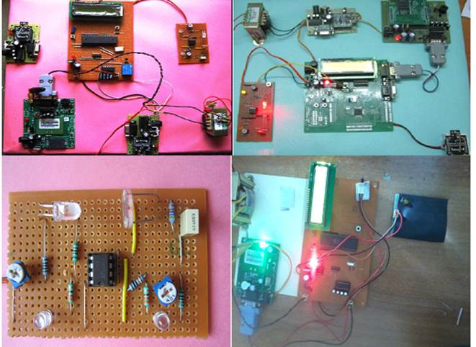
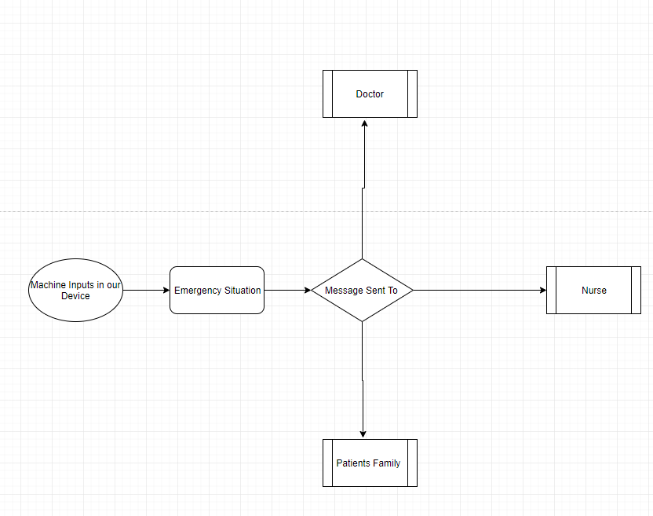
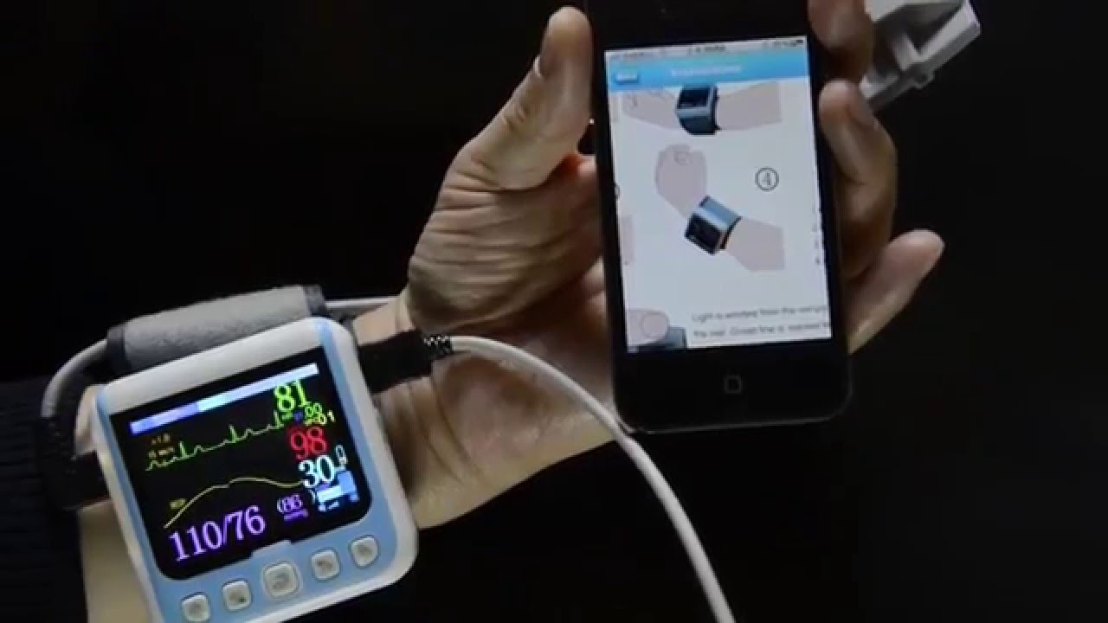
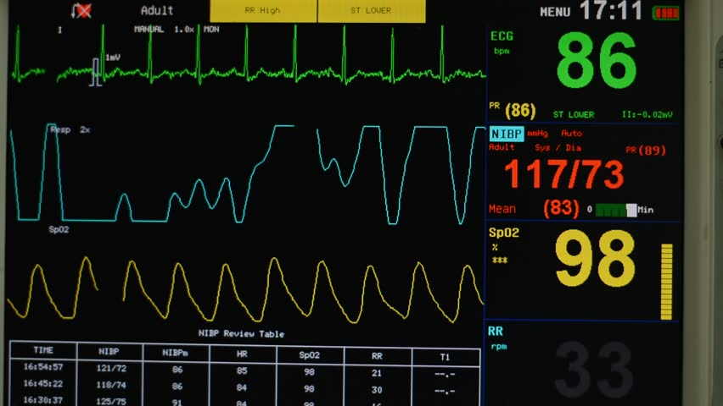
CRITICAL CARE RESPONSE
Karan Sharma(C.S.E)
Abstract
Construction/Algorithm
In critical care, the monitoring is essential to the daily care of ICU patients, as the optimization of patient’s hemodynamic, ventilation, temperature, nutrition, and metabolism is the key to improve patients' survival. With the help of our device current problem in Industry can be solved, that are:
Detection of life-threatening situations.
Detection of imminent danger.
Detection of life-threatening device malfunction.
Detection of imminent device malfunction.
Prerequisites:
An 8051 Microcontroller
A power supply unit
A RF transmitter
A receiver module
A LCD display
Introduction
An intensive care unit (ICU) is a specialized section of the hospital that provides comprehensive & continuous care for people who are critically ill and who can benefit from treatment. In ICU there are devices that measure the live status of patient health and a nurse is present 24*7 but there are chances that the nurse is out for a minute and the patients health gets down, the device we are working on helps in this situation as it takes the inputs from the devices already present in ICU and as soon as the health of patient is degraded it will ring an alarm at the observation chamber as well as sends a message to the doctor, nurse and family members of the patient on their mobile phones respectively. Even the device continues to send the live status of health to doctor and family till they make to the hospital.
Flowchart:
Results/Application
Casualties of life will be less
Less number of challenges and issues will be faced in Intensive Care Unit (ICU).
It can play major role in Hospitals.
Conclusion
Underlying Principle
The device is always connected, always on, and that “Perpetual Connectivity” to machine and users affords two key benefits:
Monitor: Continuous monitoring which provides ongoing and real-time knowledge of the condition of patient in ICU.
Maintain: Due to continual monitoring one can now push upgrades, fixes, patches, and management as needed.
Link To The Video: https://youtu.be/kJEGSAm0-m4
The CNS-6201 Central Patient Monitoring System is a full-featured system that provides comprehensive patient monitoring and review. Simple-to-use and scalable, the CNS-6201 monitors up to 32 patients using two displays and is ideal for telemetry, critical care, OR, emergency room, and other monitoring environments.
This device does what we call it CRITICAL CARE RESPONSE, as name suggests it takes all the reading from the machines already in ICU and as soon as the measurements of those machine is critical it will trigger our device and then our device starts sending SMS to the cell phones of doctors, nurse and family members of the patient.
References
http:// www.hindawi.com
http://blog.iiconsortium.org

